Slide 1
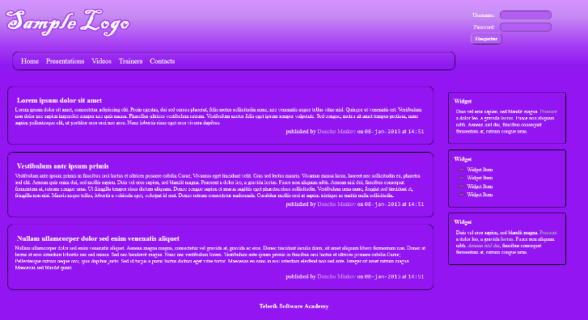
Implement the following using LESS or SASS
Use the HTML code from index.html
Create the SASS/LESS easy to change (backgrounds, fonts); Use mixins for clears, gradients

Slide 2
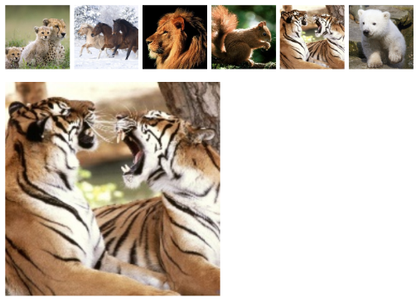
Create a web gallery
Use only HTML, SASS or LESS
List images
When a image is selected, show it zoomed

